Slide 1

Python for Data Science DAY 1 We will begin shortly!

Slide 2
Objectives
To get to know about basics of data science
Why NumPy?
NumPy functions
Getting started with pandas
Operations on pandas dataframe
To create a Nepali Tesla car (sorry no!)

Slide 3

Who am I?
Rewan Gautam
BEI 3rd Year,
IOE Thapathali Campus
rewan.com.np

Slide 4
Disclaimer
I assume that you know basics of python
Instructor does not know everything
Workshop cannot cover everything
Workshop cannot make you a data scientist

Slide 5
Introduction to data science
2.5 quintillion(10^18) bytes of data are created everyday
Over the last two years, 90% of data in the world were generated
Growth in data and computing process, data science evolved
Data Science: Domain dealing with tremendous amount of data to discover hidden patterns

Slide 6
Need of Data Science
Decision making
Personalized experience (Facebook, Google, Netflix, etc)
Foundation for AI systems

Slide 7

NumPy
Machine understands numbers
Data Science and AI is heavy computational task
Python was not made for fast numeric solutions

Slide 8

NumPy (Numerical Python)
NumPy for the rescue
Open-source python library for
scientific computing
Vectorized processing
Interpret patterns in images,
sounds, and structured data using ,
multidimensional arrays

Slide 9
Importing NumPy and creating a NumPy array
import numpy as np
a = np.array([0, 1, 2, 3])
b = np.array([[0 , 1, 2, 3],
[4, 5, 6, 7],
[8, 9, 4, 3]])

Slide 10
NumPy attributes
a.shape -> Shape of matrix, tensor
a.ndim -> No. of dimension
a.dtype -> Data type
a.size -> Number of elements

Slide 11
Operations on NumPy array
a * 2 -> Multiplies every element of a by 2
a + 2 -> Adds 2 to every element of a
a - 1 -> Subtracts every element of a by 1
a ** 2 -> Squares every element of a
a / 2 -> Divides every element of a by 2

Slide 12
Operations between NumPy arrays
a = np.array([0, 1, 2, 3])
b = np.array([1, 2, 3, 4])
a + b -> a1 + b1, a2+b2, a3+b3, a4+b4
a * b -> a1*b1, a2*b2, a3*b3, a4*b4

Slide 13
NumPy slicing
Syntax: numpy_array[start:end:step]
Default:
start = 0
end = length of array
step = 1
a = np.array([0, 5, 10, 15, 20, 25])
a[2:5:2]

Slide 14
NumPy Slicing cont...
# Get a specific row
a[row_number, :]
# Get a specific column
a[:, col_number]
# Get values less than threshold
a[a<threshold]

Slide 15
Random numbers generation
# Random distribution (0 to 1)
np.random.rand(nrow, ncol)
# Random Integer values
np.random.randint(range_a, range_b, size=(nrow, ncol))
# Random float values
np.random.uniform(range_a, range_b, size=(nrow, ncol))
# Numbers in a range (sequential)
np.arange(start, stop, stepsize)

Slide 16
Matrix initialization
np.zeros((nrow, ncol))
np.ones((nrow, ncol))
np.full((nrow, ncol), value_to_insert)
np.full_like(shape_like_of, value_to_insert)
np.identity(3)

Slide 17
Reshape
np.arange(0,10).reshape(5,2)
np.arange(0,10).reshape(2,5)

Slide 18
Stack
# Vertically stack
v1 = np.array([0, 1, 2, 3])
v2 = np.array([5, 6, 7, 8])
np.vstack([v1,v2,v1,v2])
# Horizontal stack
h1 = np.ones((2, 4))
h2 = np.zeros((2, 2))
np.hstack((h1,h2))

Slide 19
Insert values before the given indices
a = np.array([0, 1, 2, 3, 4, 5])
np.insert(a, 2, 99) -> Insert before 2nd index
np.insert(a, (3, 4, 5), (9, 8, 7)) -> Multiple at once

Slide 20
Statistical operations
a = np.array([[1,2,3],
[4,5,6]])
a.min() -> Minimum of all elements
a.max() -> Maximum of all elements
a.sum() -> Sum of all elements
a.T -> Transpose of matrix

Slide 21
Statistical operations cont..
# Dot product
a = np.array([0, 1, 2, 3])
b = np.array([5, 6, 7, 8])
np.dot(a, b)
# Matrix multiplication
a = np.array([[0, 1],
[2, 3]])
b = np.array([[5, 6],
[7, 8]])
np.dot(a, b)

Slide 22
How fast is NumPy?
Without NumPy
With NumPy
a = [i for i in range(10000000)]
b = [i for i in range(10000000)]
for i, j in zip(a, b):
dot_product += i*j
# 2.380635 seconds
a = np.array([i for i in range(10000000)])
b = np.array([i for i in range(10000000)])
dot_product = np.dot(a, b)
# 0.012966 seconds

Slide 23

: Panel Data System
Powerful python library to work with data sets
Fast, powerful, flexible and easy to use open-source data analysis and manipulation tool
Easy to clean, analyze, explore, manipulate, merge on structured data
Traditional software take lots of time and lack automation
Less code and more work done

Slide 24
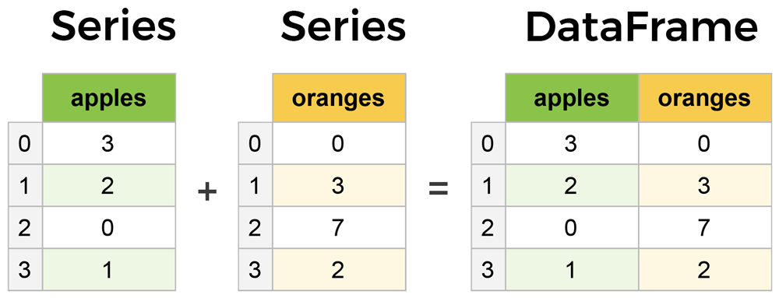
Pandas Series and DataFrame
Pandas data structures
Pandas Series:
1D array like object
Pandas DataFrame:
2D labeled data structure of pandas, similar to spreadsheet in excel

Slide 25
Loading data into Pandas DataFrame
df = pd.read_csv(file_path) -> Reading csv file
df = pd.read_excel(file_path) -> Reading excel file
df = pd.read_json(file_path) -> Reading json file
df.head() -> Show first n rows (default 5)
df.tail() -> Show last n rows (default 5)
type(df) -> See what datatype is df

Slide 26
Creating a DataFrame
data = {'Name’:
['Hari', 'Mahesh', 'Hari ko vai', 'Mahesh ko vai'],
'Interest’:
['Web', 'Mobile app', 'Data science', 'Cyber security']}
df = pd.DataFrame(data)

Slide 27
Description on the Data
df.info() -> Information about the data
df.columns -> Column/Feature list
df.shape -> Number of rows and columns
df.describe() -> Statistical description
df.isna() -> Has null value?
df.isna().sum() -> Sum of null values for each column/features
df.notna() -> Has not null value?
df.dtypes -> Datatypes of all columns/features
df.corr() -> Correlation among columns/features

Slide 28
Accessing elements
# Using index
df.iloc[0] # Row of index 0
df.iloc[[0, 1]] # Row of index 0 and 1
df.iloc[:, 0] # Column of index 0
df.iloc[:, [1, 5]] # Column of index 1 and 5
df.iloc[1, 2] = 40 # Value change
# Using label
df.loc[:, ['longitude', 'total_rooms’]] # Columns longitude and total_rooms
df.loc[(df['housing_median_age']==20) & (df['total_bedrooms']<50)]

Slide 29
Operation on columns/features
df.housing_median_age is same as df['housing_median_age’]
# Get unique values
df['housing_median_age’].unique()
# Count of unique values
df['housing_median_age'].value_counts()
df['housing_median_age'].values # Converting to numpy array
df.sort_values(by='housing_median_age').reset_index()

Slide 30
Filling missing data
df = pd.read_excel('/content/data_demo.xlsx')
df.isna().sum()
df.dropna(inplace=True) -> Drop all rows of missing values
df.fillna(value) -> Fill the missing data by value
df.fillna(df.mean()) -> Fill the missing data by mean
df.fillna(df.median()) -> Fill the missing data by median

Slide 31
Replace
df.housing_median_age.replace(to_replace,
replace_by,
inplace=True)
# Single value
df.housing_median_age.replace(15, 1, inplace=True)
# Multiple values
df.housing_median_age.replace([15, 19, 17], [0, 11111, 1111111], inplace=True)

Slide 32
Saving file
df.to_csv(‘filename.csv’) # Saving to csv
df.to_excel(‘filename.xlsx’) # Saving to excel

Slide 33
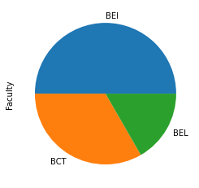
Bonus: Plotting using Pandas
Example:
df = pd.DataFrame({'Roll': [1 , 5, 10, 12, 40, 48],
'Faculty': ['BEI', 'BCT', 'BEL', 'BEI', 'BCT', 'BEI']})
df.Faculty.value_counts().plot(kind='pie’)
MORE CHARTS TOMORROW USING MATPLOTLIB AND SEABORN!

Slide 34
Assignment (NumPy):
Suppose PDSC team made a Nepali Tesla car and were testing in main road. It is on the way to Thapathali from Pulchowk. It is trying to detect number plate which it should follow as per the instruction. The number plate image was taken and was converted to array A and preprocessed with NumPy to finally detect the numbers.
Create a random numpy array A with shape (2, 4) and another array B with shape (4, 2). Both containing integer values in range 20 to 50.
Compute the dot product between those array represented by C and also find sum of elements for each array.
If sum_of_A is greater or equal to that of sum_of_B, compute transpose of C and if it's false, multiply each element of array C by 9.
Display the result.

Slide 35
Assignment (Pandas):
Load the data from link: https://raw.githubusercontent.com/pdscorg/Data/main/Life%20Expectancy%20Data.csv in pandas dataframe.
Check if it contains missing value.
Try, dropping the rows containing missing values.
If you found more than 200 rows being dropped, load the data again and fill the missing values with mean.
Manipulate the dataframe by keeping only the data having Life expectancy above 80.
Take first 5 columns of the dataframe and save it to csv file
(Submit the csv file and the notebook/python file)

Slide 36
THANK YOU!

